Slide 1
Graphs – Shortest Path (Weighted Graph)
1843
ORD
SFO
802
337
1743
LAX
1233
DFW

Slide 2
Outline
The shortest path problem
Single-source shortest path
Shortest path on a directed acyclic graph (DAG)
Shortest path on a general graph: Dijkstra’s algorithm

Slide 3
Outline
The shortest path problem
Single-source shortest path
Shortest path on a directed acyclic graph (DAG)
Shortest path on a general graph: Dijkstra’s algorithm

Slide 4
Shortest Path on Weighted Graphs
BFS finds the shortest paths from a source node s to every vertex v in the graph.
Here, the length of a path is simply the number of edges on the path.
But what if edges have different ‘costs’?
7
1
5
v
v
s
2
s
2
3

Slide 5
Weighted Graphs
In a weighted graph, each edge has an associated numerical value, called the weight of the edge
Edge weights may represent, distances, costs, etc.
Example:
In a flight route graph, the weight of an edge represents the distance in miles between the endpoint airports
849
PVD
1843
ORD
142
SFO
802
LGA
1743
1205
337
1387
HNL
2555
1099
LAX
1233
DFW
1120
MIA

Slide 6
Shortest Path on a Weighted Graph
Given a weighted graph and two vertices u and v, we want to find a path of minimum total weight between u and v.
Length of a path is the sum of the weights of its edges.
Example:
Shortest path between Providence and Honolulu
Applications
Internet packet routing
Flight reservations
Driving directions
849
PVD
1843
ORD
142
SFO
802
LGA
1743
1205
337
1387
HNL
2555
1099
LAX
1233
DFW
1120
MIA

Slide 7
Shortest Path: Notation
Input:

Slide 8
Shortest Path Properties
Property 1 (Optimal Substructure):
A subpath of a shortest path is itself a shortest path
Property 2 (Shortest Path Tree):
There is a tree of shortest paths from a start vertex to all the other vertices
Example:
Tree of shortest paths from Providence
849
PVD
1843
ORD
142
SFO
802
LGA
1743
1205
337
1387
HNL
2555
1099
LAX
1233
DFW
1120
MIA

Slide 9
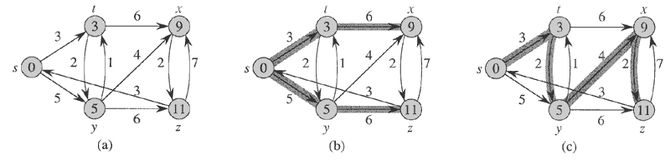
Shortest path trees are not necessarily unique
Single-source shortest path search induces a search tree rooted at s.
This tree, and hence the paths themselves, are not necessarily unique.

Slide 10
Optimal substructure: Proof
Lemma: Any subpath of a shortest path is a shortest path
Proof: Cut and paste.

Slide 11
Shortest path variants
Single-source shortest-paths problem: – the shortest path from s to each vertex v.
Single-destination shortest-paths problem: Find a shortest path to a given destination vertex t from each vertex v.
Single-pair shortest-path problem: Find a shortest path from u to v for given vertices u and v.
All-pairs shortest-paths problem: Find a shortest path from u to v for every pair of vertices u and v.

Slide 12
Negative-weight edges
OK, as long as no negative-weight cycles are reachable from the source.
If we have a negative-weight cycle, we can just keep going around it, and get w(s, v) = −∞ for all v on the cycle.
But OK if the negative-weight cycle is not reachable from the source.
Some algorithms work only if there are no negative-weight edges in the graph.

Slide 13
Cycles
Shortest paths can’t contain cycles:
Already ruled out negative-weight cycles.
Positive-weight: we can get a shorter path by omitting the cycle.
Zero-weight: no reason to use them → assume that our solutions won’t use them.

Slide 14
Outline
The shortest path problem
Single-source shortest path
Shortest path on a directed acyclic graph (DAG)
Shortest path on a general graph: Dijkstra’s algorithm

Slide 15
Output of a single-source shortest-path algorithm
For each vertex v in V:
d[v] = δ(s, v).
Initially, d[v]=∞.
Reduce as algorithm progresses.
But always maintain d[v] ≥ δ(s, v).
Call d[v] a shortest-path estimate.
π[v] = predecessor of v on a shortest path from s.
If no predecessor, π[v] = NIL.
π induces a tree — shortest-path tree.

Slide 16
Initialization
All shortest-path algorithms start with the same initialization:
INIT-SINGLE-SOURCE(V, s)
for each v in V
do d[v]←∞
π[v] ← NIL
d[s] ← 0

Slide 17
Relaxing an edge
Can we improve shortest-path estimate for v by first going to u and then following edge (u,v)?
RELAX(u, v, w)
if d[v] > d[u] + w(u, v) then
d[v] ← d[u] + w(u, v)
π[v]← u

Slide 18
General single-source shortest-path strategy
Start by calling INIT-SINGLE-SOURCE
Relax Edges
Algorithms differ in the order in which edges are taken and how many times each edge is relaxed.

Slide 19
Outline
The shortest path problem
Single-source shortest path
Shortest path on a directed acyclic graph (DAG)
Shortest path on a general graph: Dijkstra’s algorithm

Slide 20
Example 1. Single-Source Shortest Path on a Directed Acyclic Graph
Basic Idea: topologically sort nodes and relax in linear order.
Efficient, since δ[u] (shortest distance to u) has already been computed when edge (u,v) is relaxed.
Thus we only relax each edge once, and never have to backtrack.

Slide 21
Example: Single-source shortest paths in a directed acyclic graph (DAG)
Since graph is a DAG, we are guaranteed no negative-weight cycles.
Thus algorithm can handle negative edges

Slide 22
Algorithm

Slide 23
Example

Slide 24
Example

Slide 25
Example

Slide 26
Example

Slide 27
Example

Slide 28
Example

Slide 29
Correctness: Path relaxation property

Slide 30
Correctness of DAG Shortest Path Algorithm
Because we process vertices in topologically sorted order, edges of any path are relaxed in order of appearance in the path.
→Edges on any shortest path are relaxed in order.
→By path-relaxation property, correct.

Slide 31
Outline
The shortest path problem
Single-source shortest path
Shortest path on a directed acyclic graph (DAG)
Shortest path on a general graph: Dijkstra’s algorithm

Slide 32
Example 2. Single-Source Shortest Path on a General Graph (May Contain Cycles)
This is fundamentally harder, because the first paths we discover may not be the shortest (not monotonic).

Slide 33
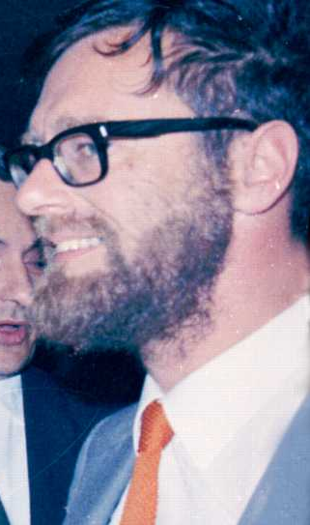
Dijkstra’s algorithm (E. Dijkstra,1959)
Applies to general, weighted, directed or undirected graph (may contain cycles).
But weights must be non-negative. (But they can be 0!)
Essentially a weighted version of BFS.
Instead of a FIFO queue, uses a priority queue.
Keys are shortest-path weights (d[v]).
Maintain 2 sets of vertices:
S = vertices whose final shortest-path weights are determined.
Q = priority queue = V-S.
Edsger Dijkstra

Slide 34
Dijkstra’s Algorithm: Operation
We grow a “cloud” S of vertices, beginning with s and eventually covering all the vertices
We store with each vertex v a label d(v) representing the distance of v from s in the subgraph consisting of the cloud S and its adjacent vertices
At each step
We add to the cloud S the vertex u outside the cloud with the smallest distance label, d(u)
We update the labels of the vertices adjacent to u
s
S
9
1
4
11
7

Slide 35
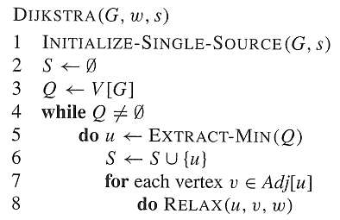
Dijkstra’s algorithm
Dijkstra’s algorithm can be viewed as greedy, since it always chooses the “lightest” vertex in V − S to add to S.

Slide 36
Dijkstra’s algorithm: Analysis
Analysis:
Using minheap, queue operations takes O(logV) time

Slide 37
Example
Key:

Slide 38
Example

Slide 39
Example

Slide 40
Example

Slide 41
Example

Slide 42
Example

Slide 43
Djikstra’s Algorithm Cannot Handle Negative Edges
2
3
-2
1
s
x
y
z

Slide 44
Correctness of Dijkstra’s algorithm
Loop invariant: d[v] = δ(s, v) for all v in S.
Initialization: Initially, S is empty, so trivially true.
Termination: At end, Q is empty →S = V → d[v] = δ(s, v) for all v in V.
Maintenance:
Need to show that
d[u] = δ(s, u) when u is added to S in each iteration.
d[u] does not change once u is added to S.

Slide 45
Correctness of Dijkstra’s Algorithm: Upper Bound Property
Upper Bound Property:
Proof:
A valid path from s to v!

Slide 46
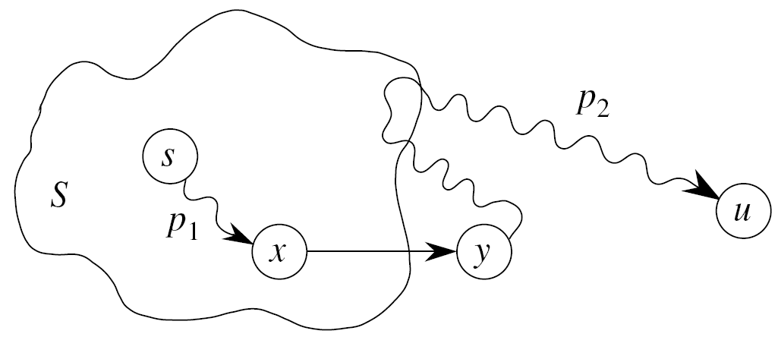
Correctness of Dijkstra’s Algorithm
Optimal substructure property!
Handled

Slide 47
Correctness of Dijkstra’s Algorithm
Handled

Slide 48
Correctness of Dijkstra’s algorithm
Loop invariant: d[v] = δ(s, v) for all v in S.
Maintenance:
Need to show that
d[u] = δ(s, u) when u is added to S in each iteration.
d[u] does not change once u is added to S.
✓
?

Slide 49
Outline
The shortest path problem
Single-source shortest path
Shortest path on a directed acyclic graph (DAG)
Shortest path on a general graph: Dijkstra’s algorithm

